Slide 1

GLA UNIVERSITY
TOPIC: MINI PROJECT (Movie recommeder )

Slide 2
SUBMITTED BY: SUBMITTED TO:
Name : Abhishek Pal
Uni. Roll No.: 201500013
Mrs. Gurpreet Kaur
Technical Trainer
GLA University, Mathura

Slide 3
INTRODUCTION A movie recommendation system, or a movie recommender system, is an ML-based approach to filtering or predicting the users' film preferences based on their past choices and behavior.

Slide 4
About the Project The project named “Movie recommender” is a Machine learning (ML) is a branch of artificial intelligence (AL) that enable computer to self-learn from training data and improve over time, without being explicitly programmed. Machine learning algorithms are able to detect patterns in data and learn from them, in order to make their own predictions.

Slide 5
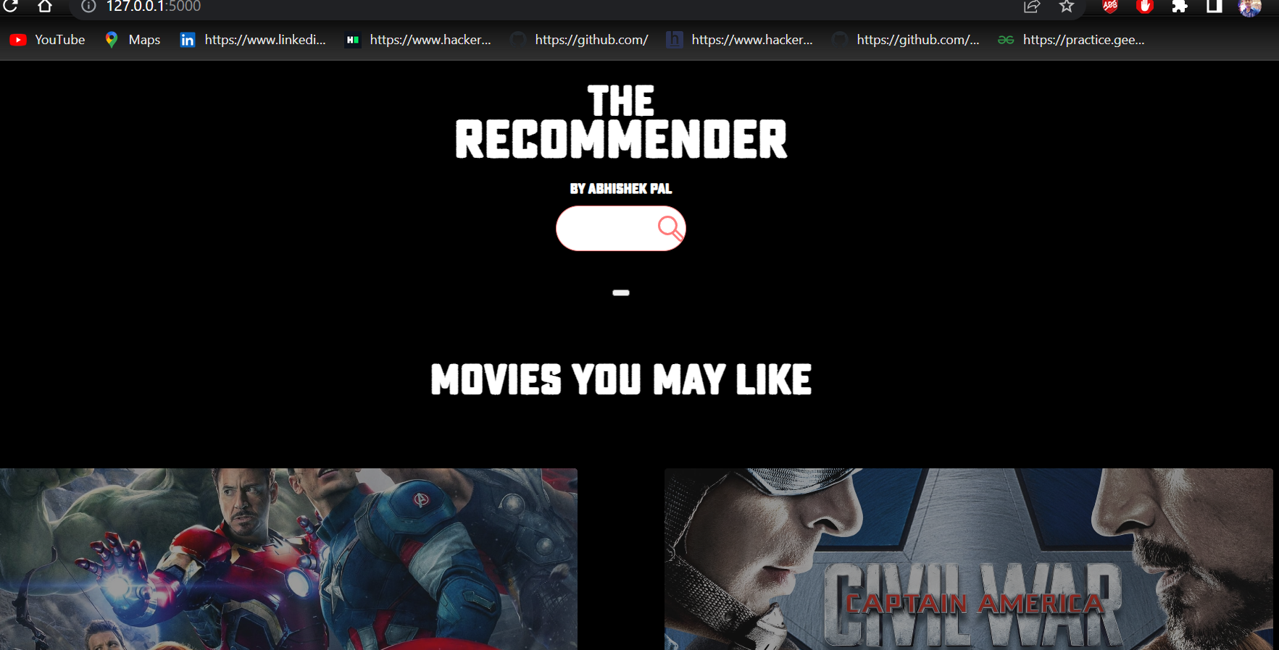
THIS IS HOW FRONTEND LOOKS LIKE

Slide 6
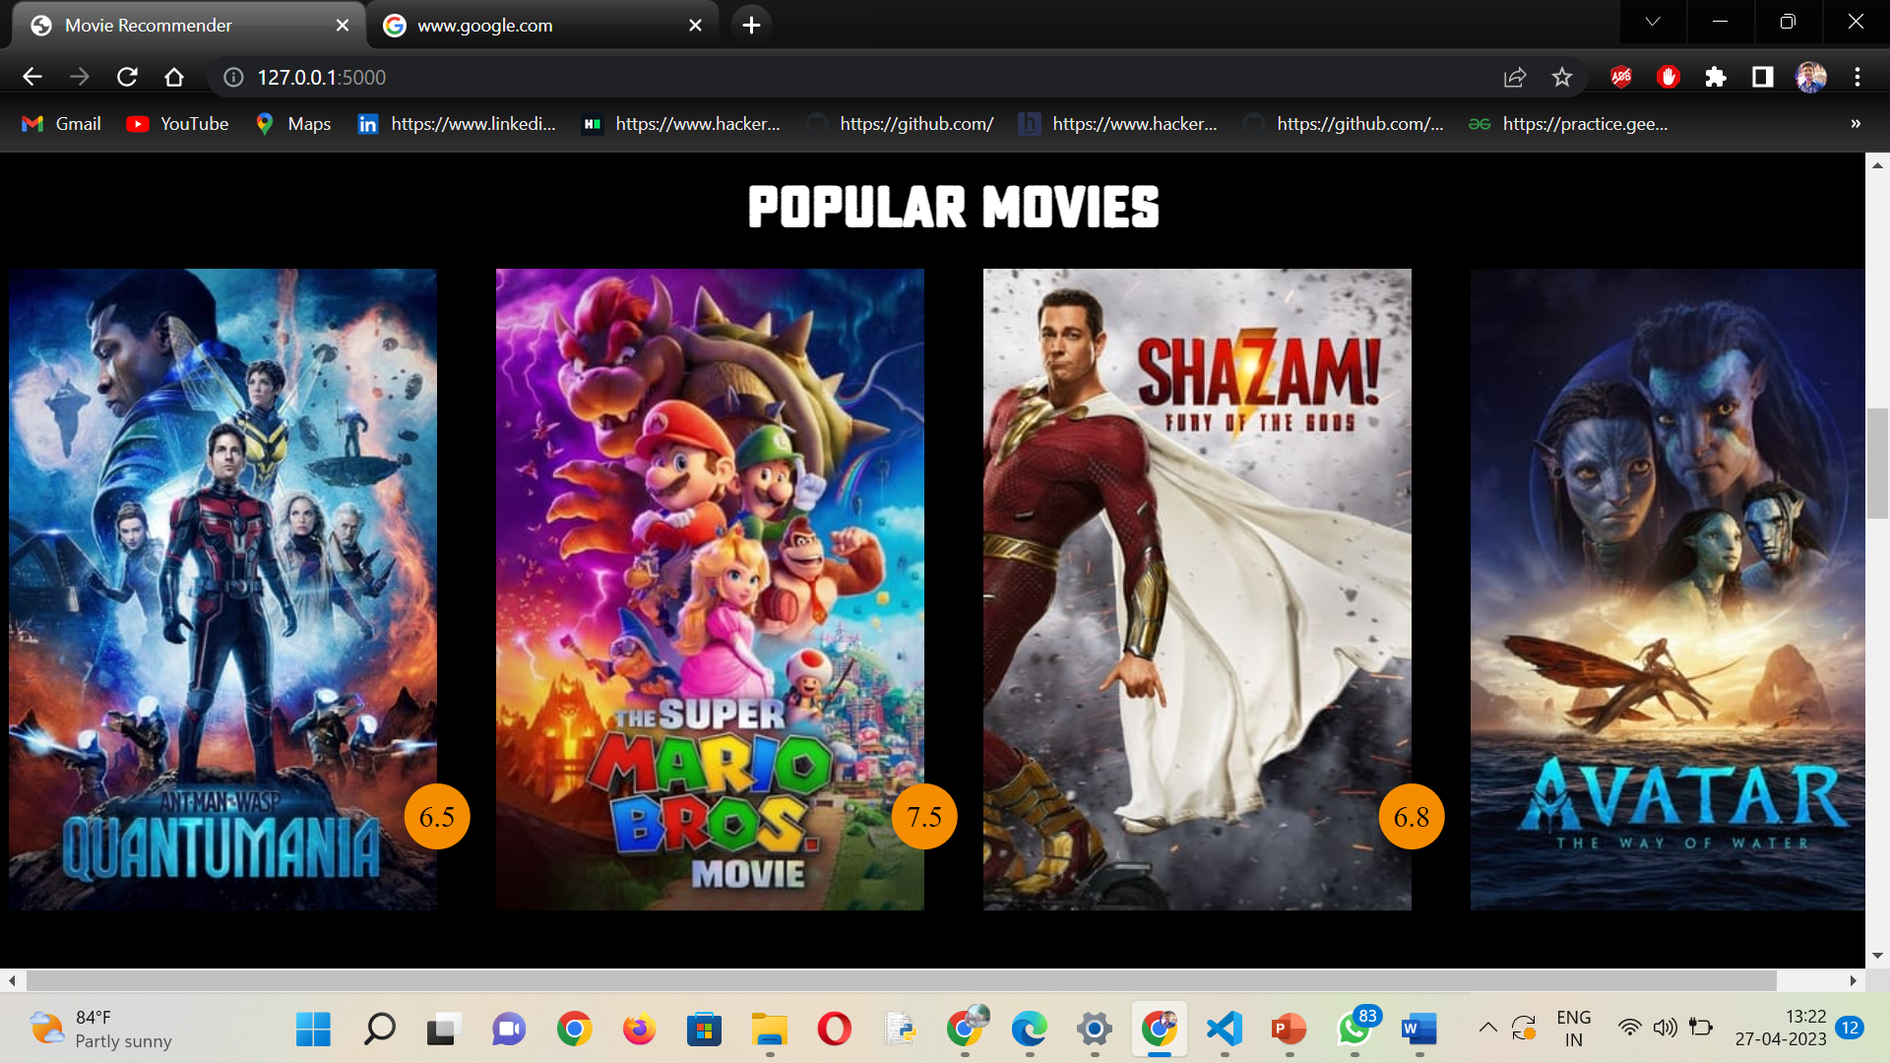
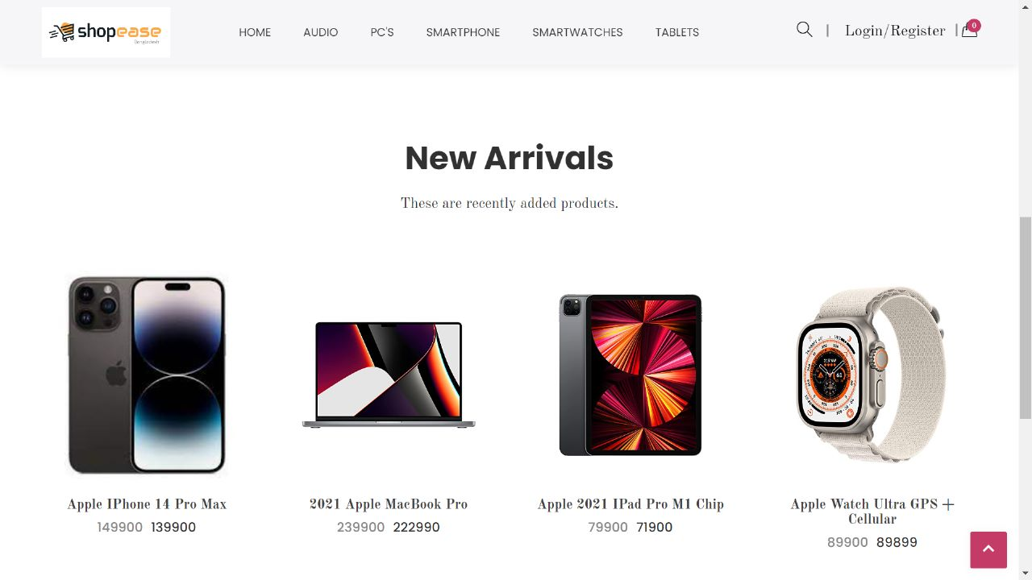

Slide 7
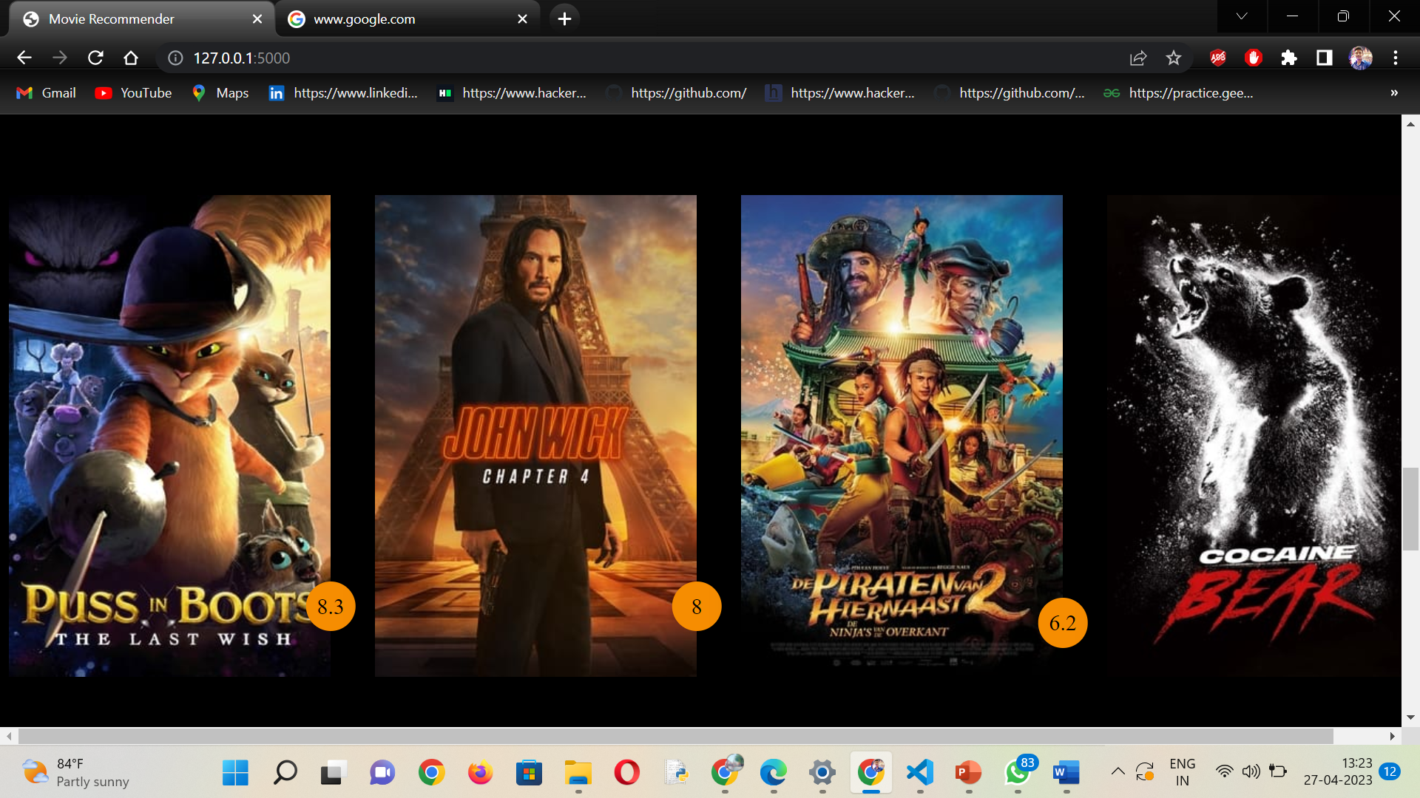

Slide 8
TECHNOLOGIES USED
NUMPY
PANDAS
NLP (Natural language processing)
SKLEARN
VECTORIZATION
PREPROCESSING
DATASETS

Slide 9
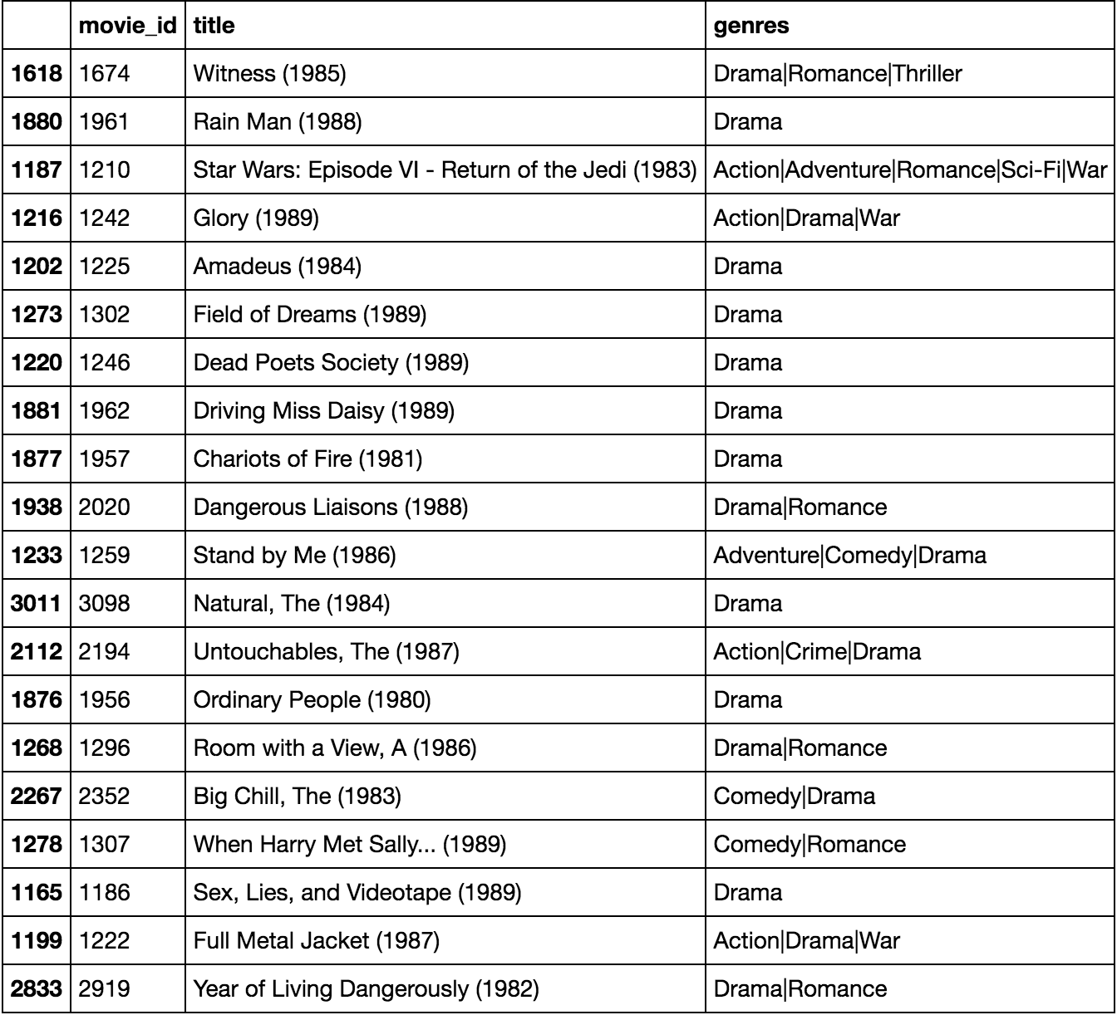
The Recommendation

Slide 10
Thank you

